Slide 1
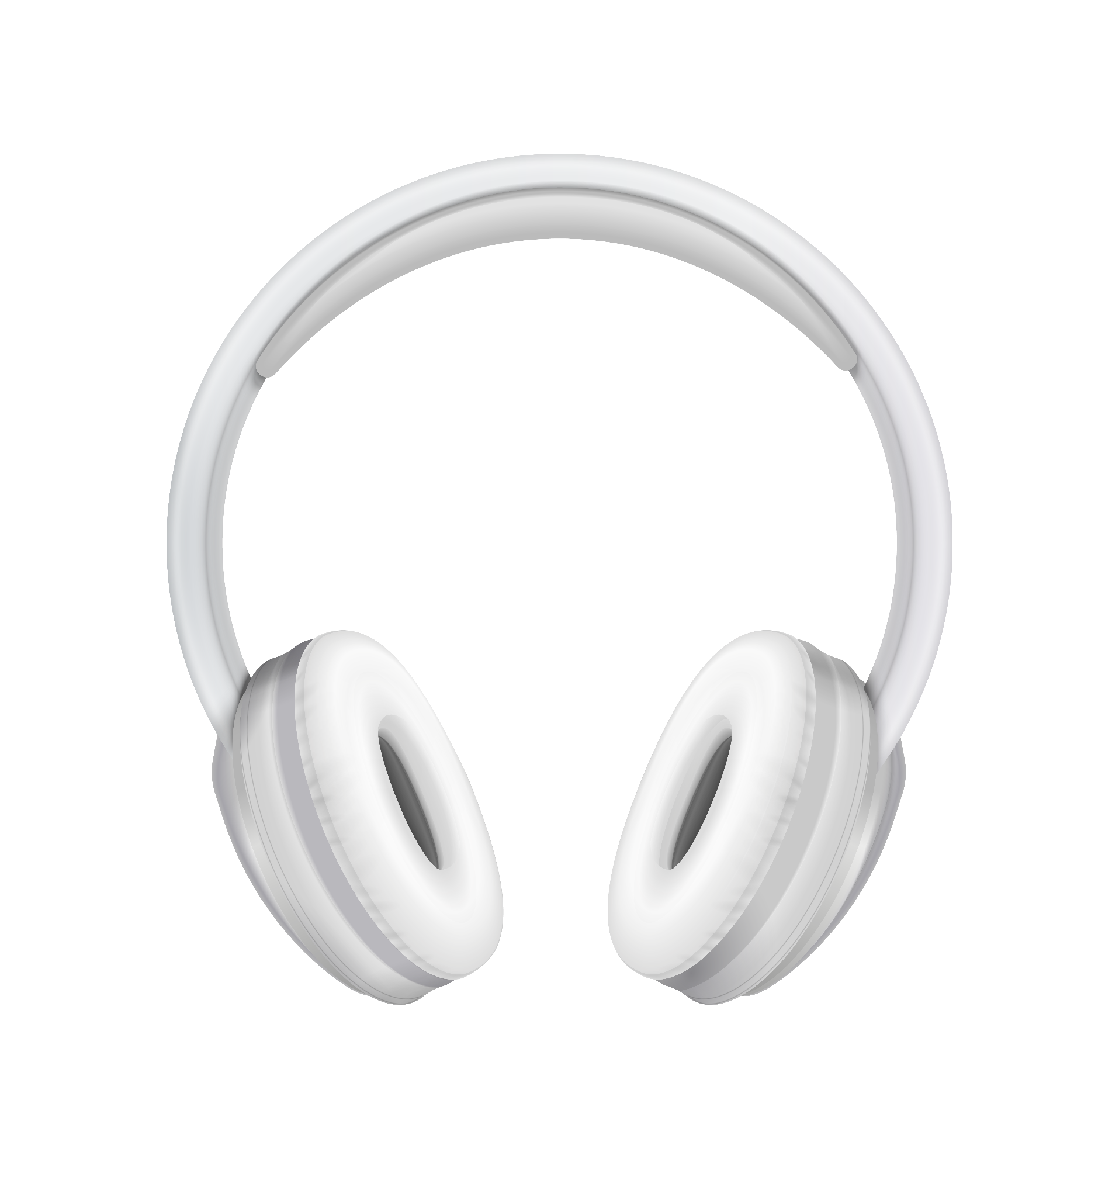
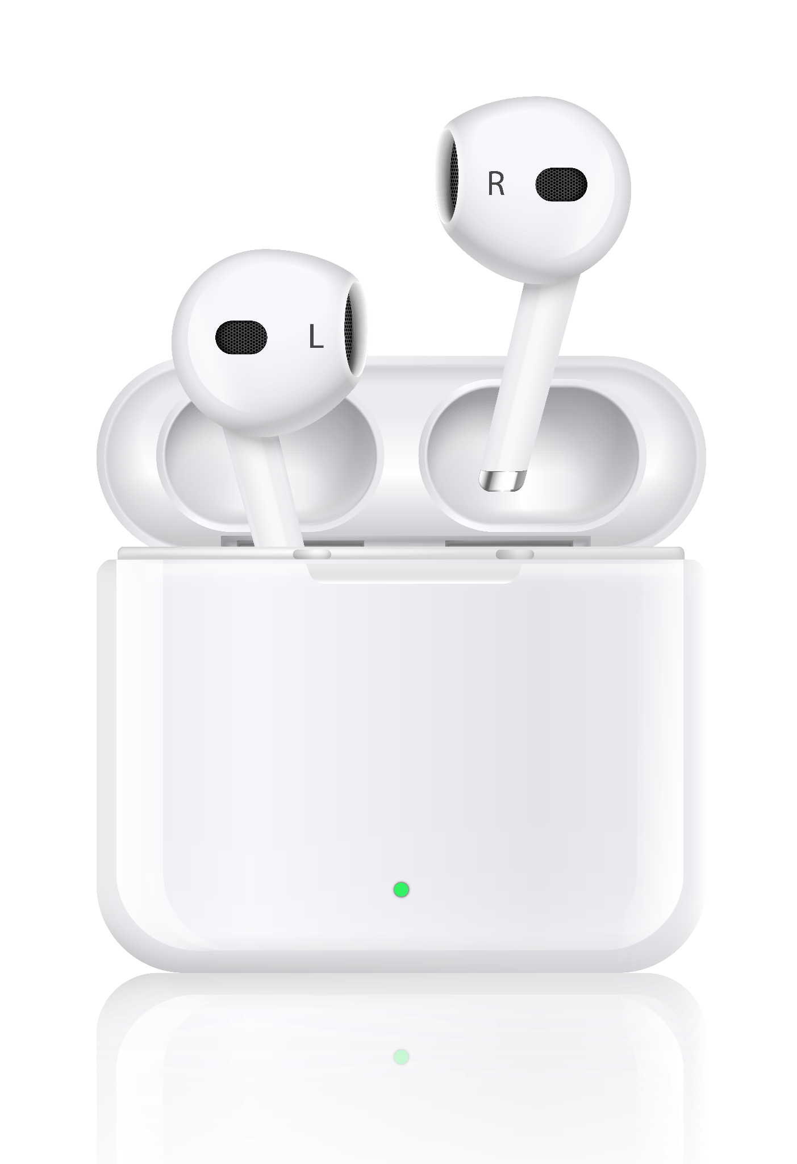
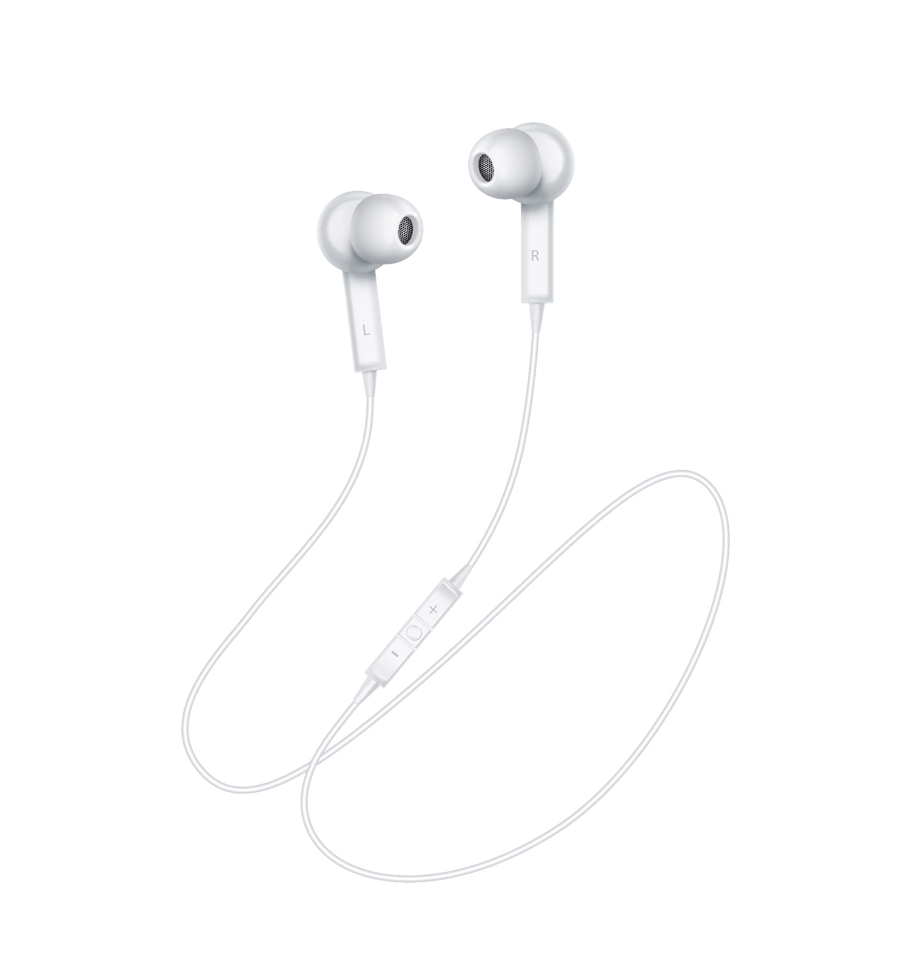
Wireless Earphones & Headphones
Company Profile
Here is where your presentation begins

Slide 2
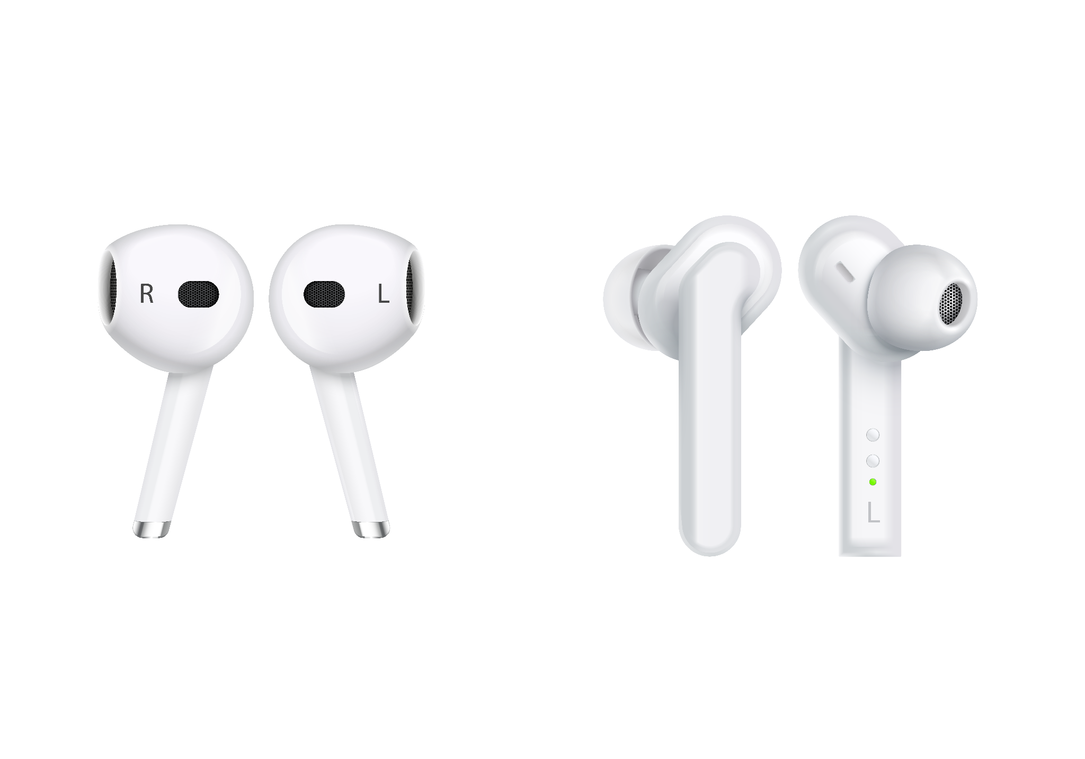
1. Web Scraping
Extracted earbuds product data using BeautifulSoup / Scrapy
Features: Name, Price, Category, Ratings, Reviews
Saved dataset to CSV

Slide 3
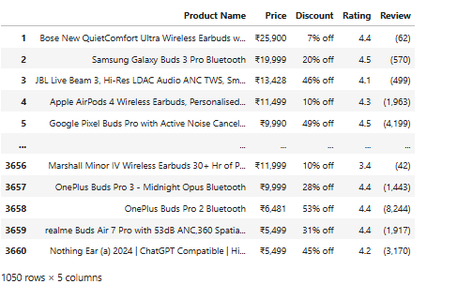
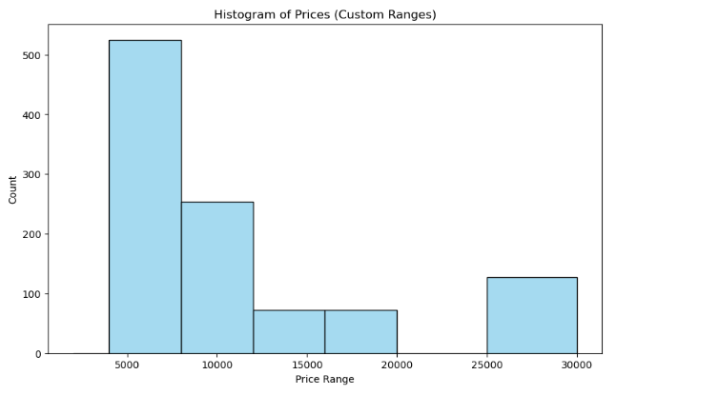
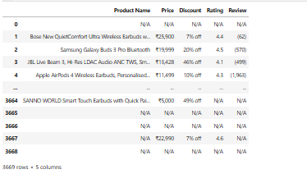
2. Data Cleaning
Handled missing values, duplicates, irrelevant entries
Standardized formats (currency, text casing)
Performed EDA for distributions & insights

Slide 4
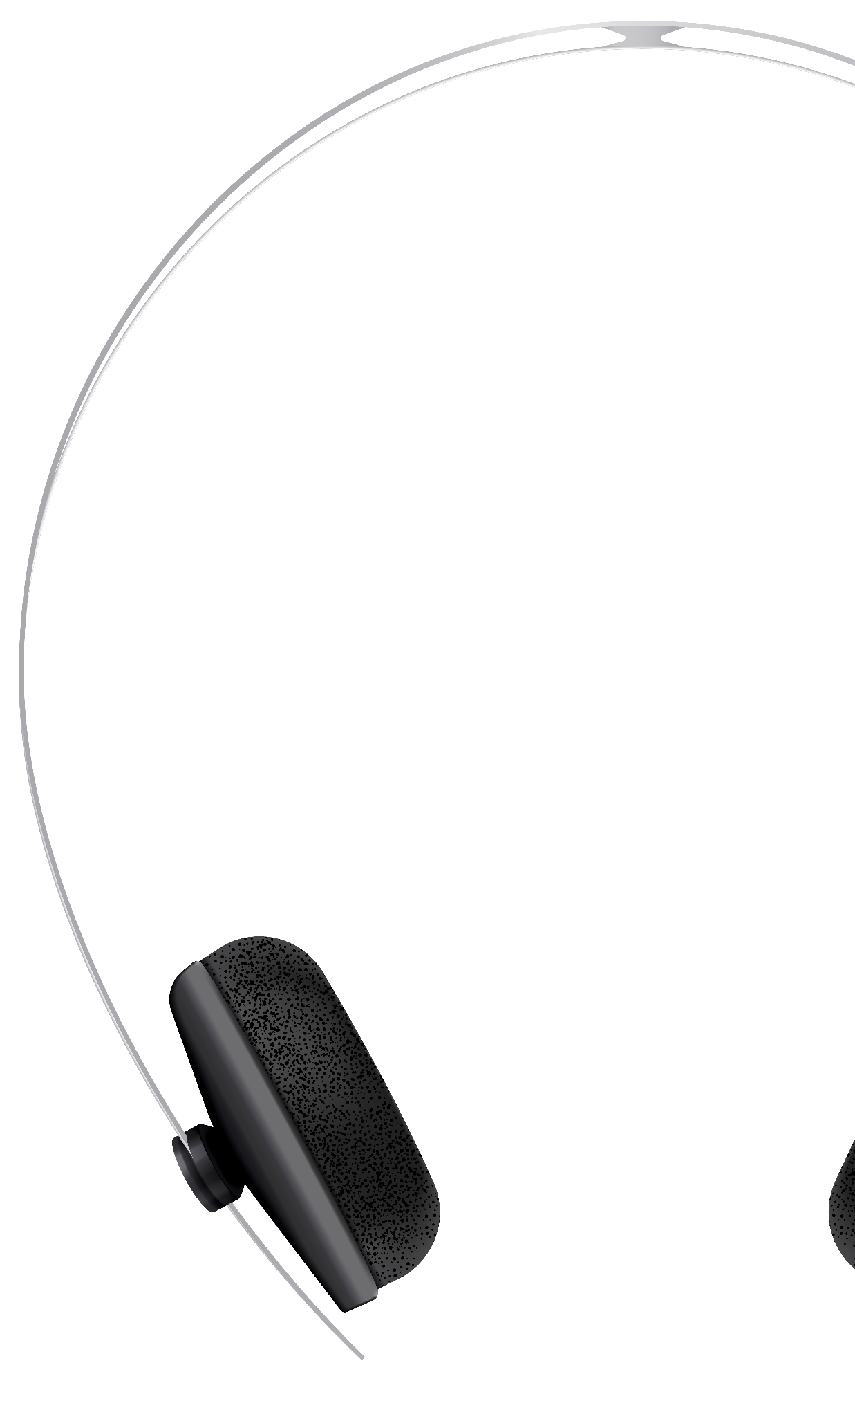
3. Data Storage
Created relational database using MySQL / SQLite
Used SQLAlchemy for Python integration
Stored cleaned dataset in 'products' table
EX:
import sqlalchemy
engine = sqlalchemy.create_engine('mysql+pymysql://magnathan:Butti@24@localhost:3306/Earphones')

Slide 5
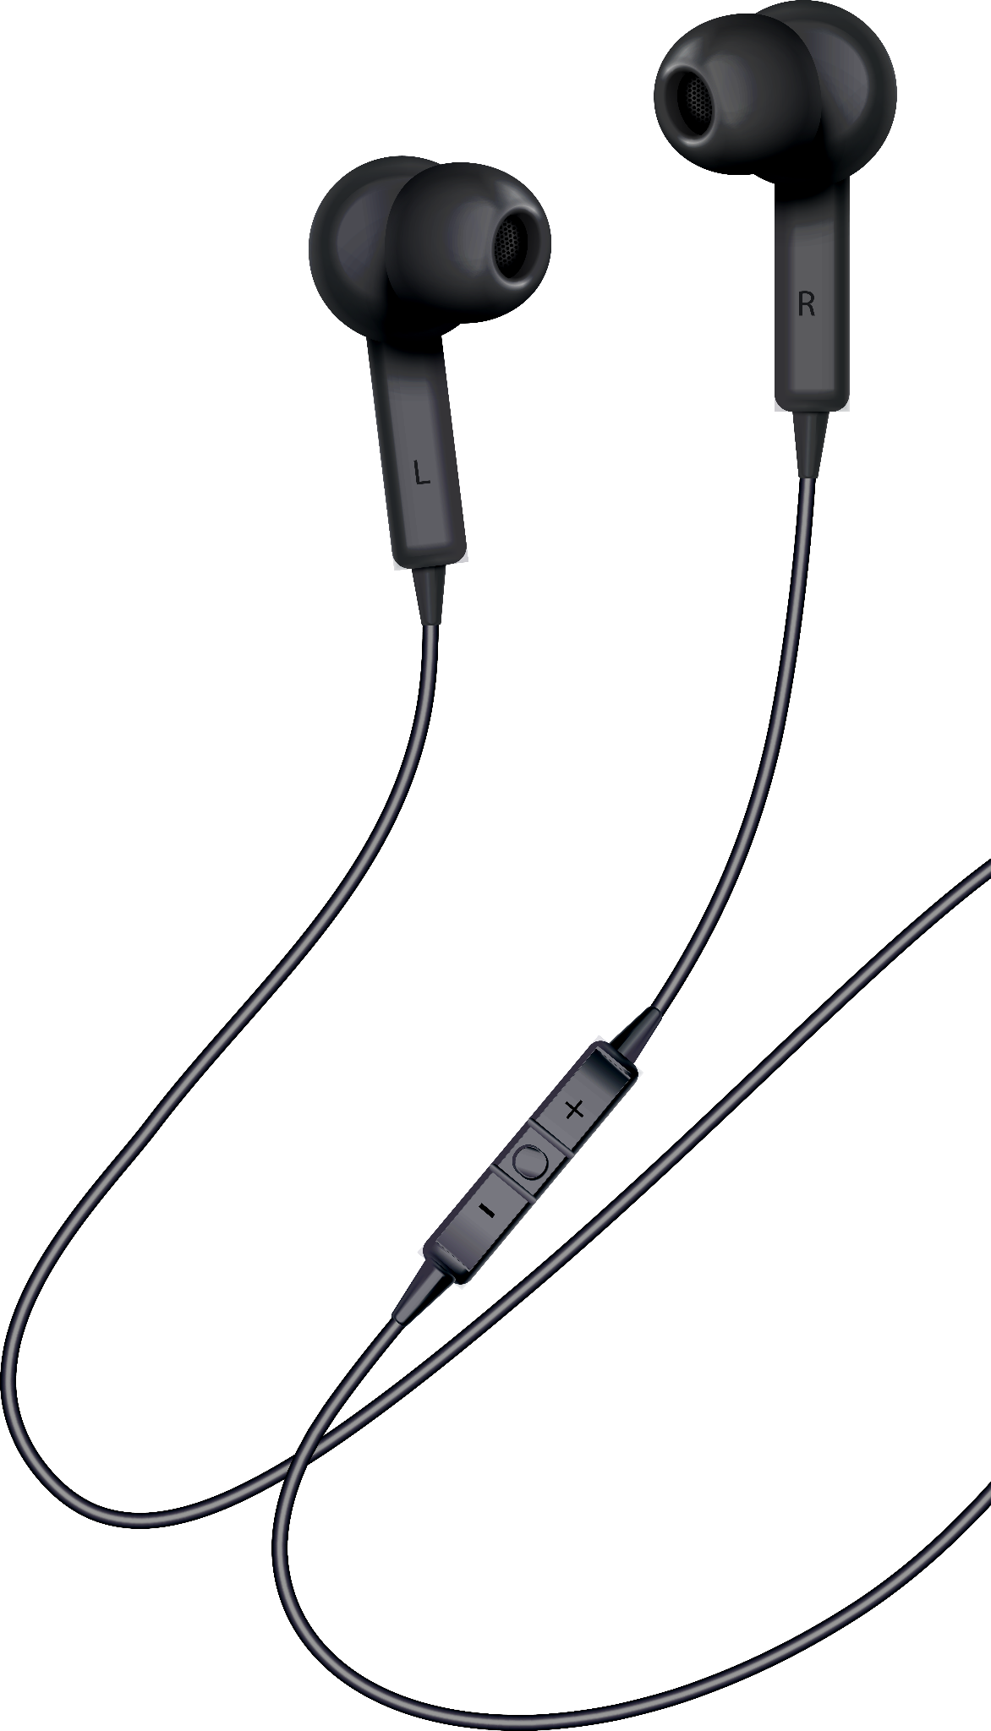
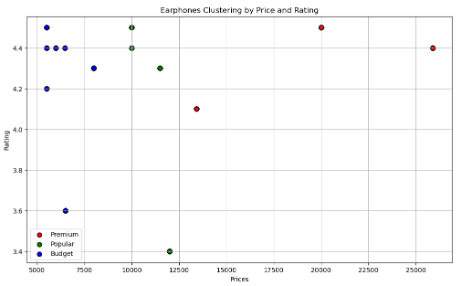
4. Unsupervised Learning
Applied K-Means clustering on Price, Ratings, Reviews
Tested cluster sizes (3)
Added 'Cluster' column to dataset

Slide 6

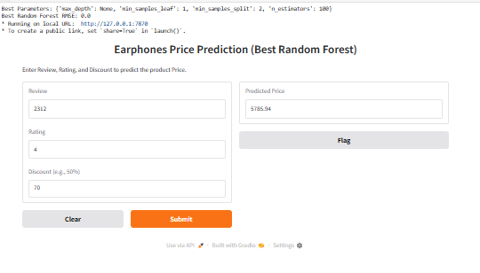
5. Supervised Learning
Target: Product Category
Models: Logistic Regression, SVM, k-NN, Random Forest, XGBoost
Evaluated with Accuracy, Precision, Recall, F1 Score

Slide 7
6. Hyperparameter Tuning
Grid Search CV / Randomized Search CV
Tuned learning rate, tree count, C, gamma
Optimized model accuracy and F1 Score

Slide 8
7.Key Insights
Clustered products into Budget, Mid-range, Premium, Niche
Random forest improved from 88% → 92% after tuning
Random Forest achieved highest accuracy (~92%)

Slide 9
8.Conclusion
End-to-end workflow: Scraping → Cleaning → Storage → ML
Unsupervised + Supervised Learning applied successfully
Scalable for broader e-commerce analysis

Slide 10
Thank you

